Slide 1
Olist Seller Evaluation & Channel Analysis
PRESENTED BY: Abdulla Alhayki, Sayed Hashim, Mujtuba Alnashaba | Group 7

Slide 2
Problem Statement & Objectives
Olist needs to know if the channels and sales people it uses to acquire new business have been bringing in high-caliber sellers, and if the sellers' performance is consistent among the different seller types and regions.
Acquisition Quality
Seller Performance
Geographic Gaps
Evaluate channel performance, seller activity, orders, sales and reviews
Identify best performers and problem sellers
Identify states where there are customers but no sellers
Recommend steps for acquisitions, onboarding and logistics

Slide 3
Dataset Overview & Data Preparation
-Order data: 99,441 orders, 99,441 customers, 3,095 sellers; Marketing Funnel: 8,000 MQLs, 842 deals closed
-Table relating sellers and orders: 100,010 records (97,819 shipped), 2,970 sellers with shipped orders
- No duplicates found; row counts verified after each merge operation
763 orders lacking reviews have been marked as null and removed from calculations
-Calculations started with an average per order and followed by calculation per seller

Slide 4
Key Terms
MQL
Potential seller who passed through the marketing funnel.
Closed Deal
An MQL which became an Olist seller
Source of Origin
The method of customer acquisition like PPC, SEO, or referrals.
SDR / SR
Employee who worked on selling to or closing the seller.
Active Seller
The most recent order for that particular seller falls within 7 days from the last order date.
Late Delivery Ratio
Number of late deliveries over total number of deliveries.

Slide 5
PRELIMINARY FINDINGS
Lead Funnel & Seller Composition
8,000
842
10.52%
Marketing-qualified leads
Closed / won sellers
Lead-to-seller conversion
3,095
587 / 242
32 / 22
Sellers in the e-commerce data
Resellers / manufacturers (rest missing or other)
Distinct SDRs / SRs
.

Slide 6
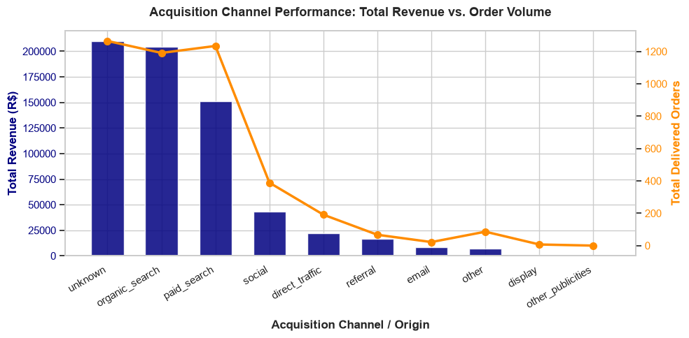
How do sellers compare across acquisition channels, and are referrals the best?
Notes:
Unknown, organic search and paid search generate nearly all revenue and orders; referral is small.

Slide 7
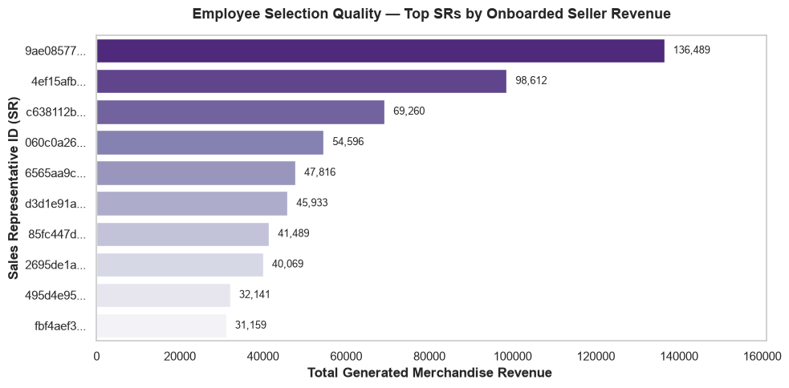
Are employees (sales reps) selecting the right sellers?
Notes:
Top SR onboarded sellers generating R$136,489 in merchandise revenue.

Slide 8
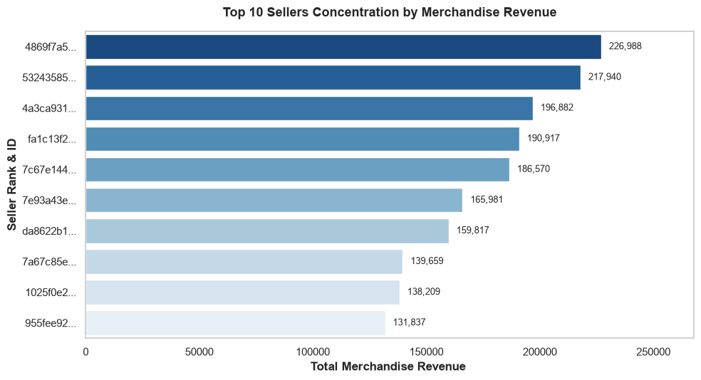
Who are the top-performing sellers?
Notes:
Top seller: R$226,988 merchandise revenue.

Slide 9
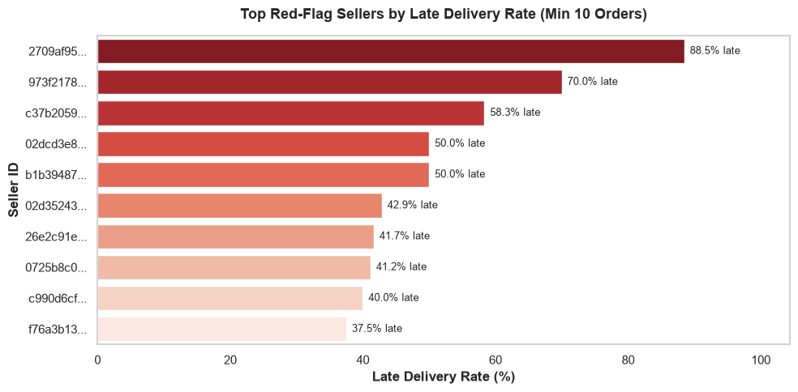
Who are the red-flag sellers and why?
Notes:
Worst seller: 88.5% late deliveries (min 10 orders).

Slide 10
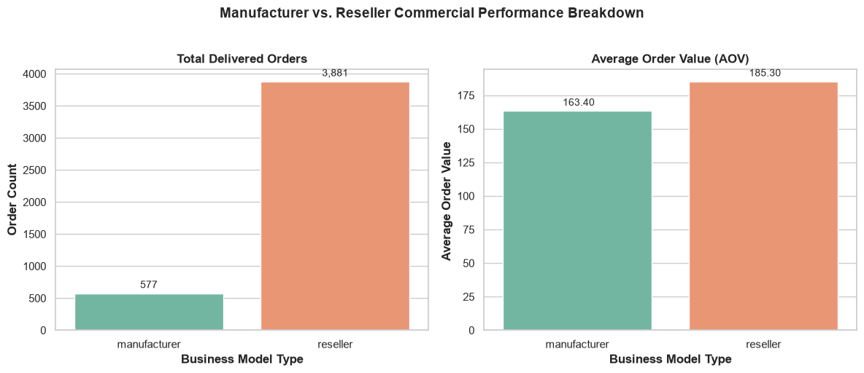
Manufacturers vs. resellers: how do they compare?
Notes:
Resellers: 3,881 orders, AOV 185.30. Manufacturers: 577 orders, AOV 163.40.

Slide 11
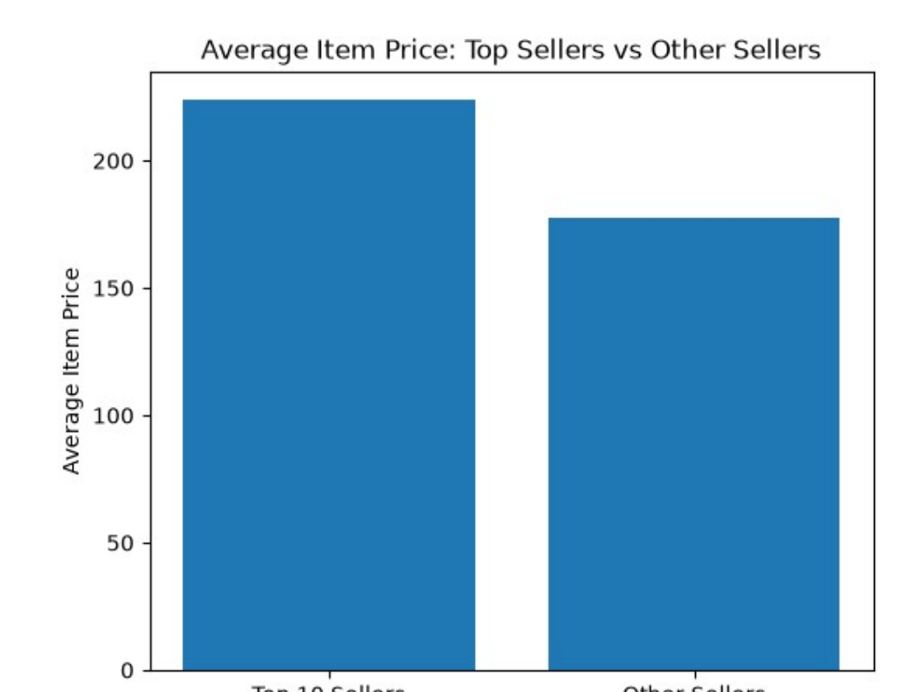
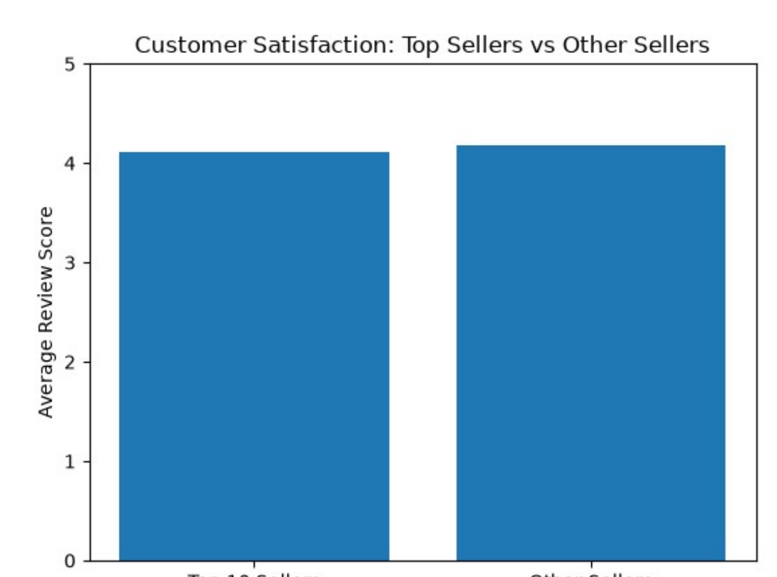
Are top sellers successful because of price or customer satisfaction?
While top sellers charge higher product prices (223.75 versus 177.50) but have a lower number of reviews (4.11 versus 4.18), this points out that their sales success depends on price rather than customer reviews..

Slide 12
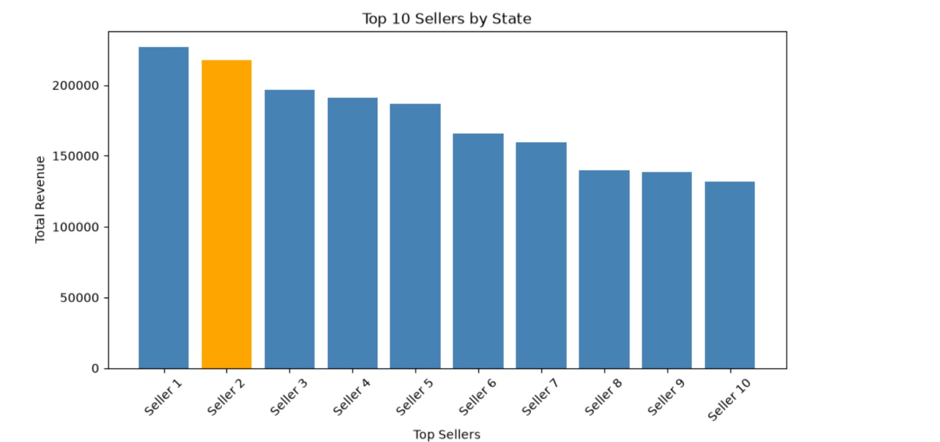
Where are the top sellers located?
SP
BA

Slide 13
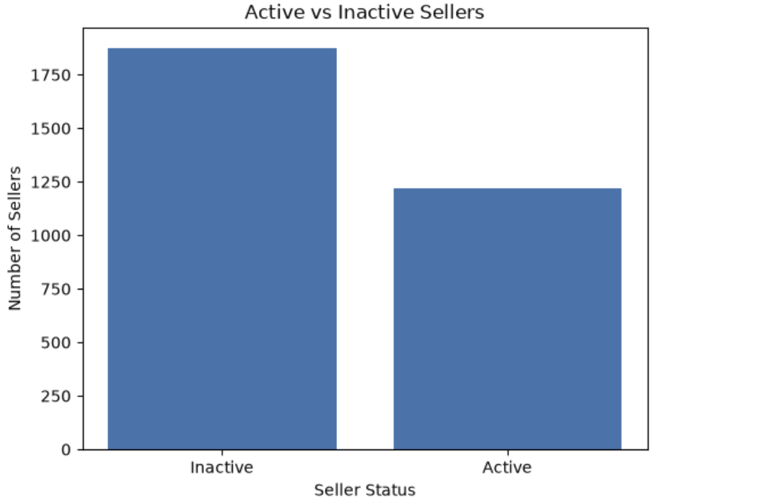
How many sellers do we have, and are all active?
Definition used: Active seller = most recent order within 30 days of the final order date in the dataset.
3,095 total sellers
1,221 active sellers
1,874 inactive sellers
Not all sellers are active. The inactive group is larger than the active group under the 30-day activity definition.

Slide 14
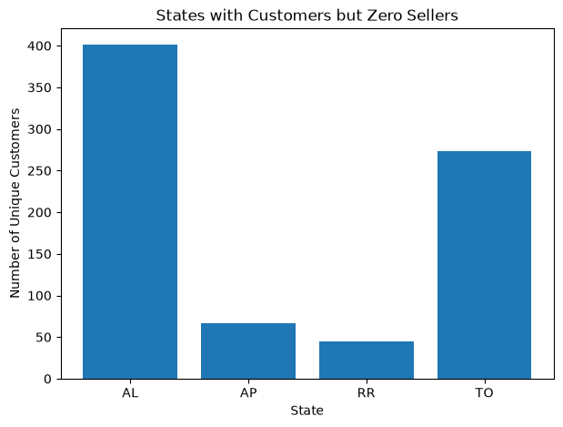
Which states have customers but zero sellers?
Notes:
AL 401, TO 273, AP 67, RR 45 customers.

Slide 15
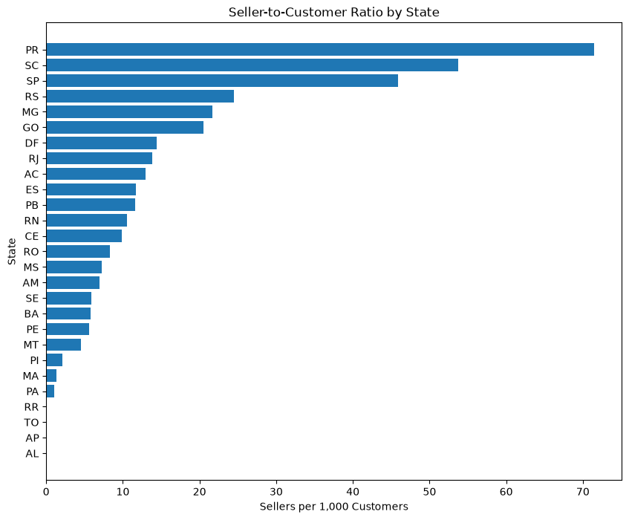
Do we have a good seller-to-customer ratio?
Notes:
PR highest, about 71 sellers per 1,000 customers.

Slide 16
Seller Activation After Signing
842 signed sellers
133 sold within 30 days
250 sold within 60 days
84.2% of the signed sellers have not made a first sale within 30 days and 70.31% have not made a first sale within 60 days.
.
There is clearly an onboarding problem. The new sellers require assistance and follow-ups for 30-60 days for better activation
.

Slide 17
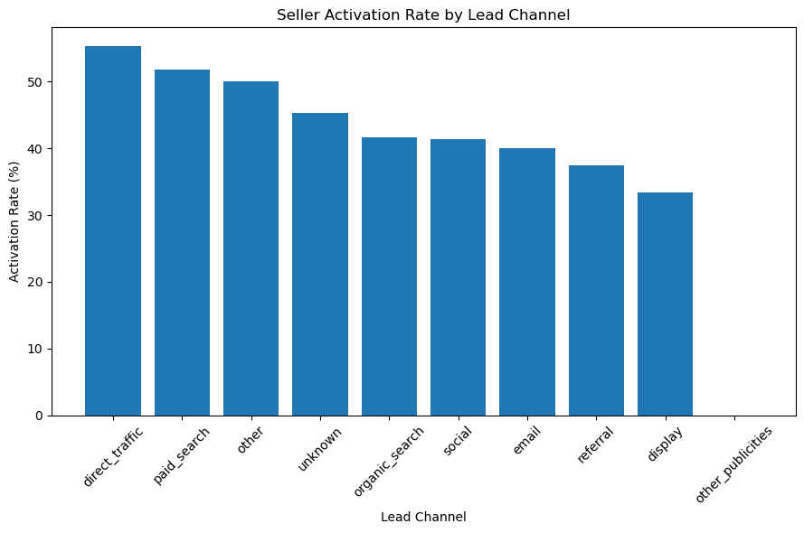
Which lead channel brings the most retained sellers? Activation rate by channel
Notes:
Direct traffic 55.4%, paid search 51.8%, other 50%, unknown 45.3%, organic 41.7%.

Slide 18
Recommendations
Acquisition
Paid search should take priority; testing direct traffic and better unknown channel attribution continues.
Onboarding
Include structured first sale program in first 30-60 days.
Employees
Bench the best SR’s/SDR’s and help develop poor performing teams.
Seller type
Create separate benchmarks for resellers and manufacturers.
Geography
Focus on acquiring sellers from AL first, then TO, AP and RR.
Delivery
Focus on slower seller states like MA and CE first prior to benchmarking.
Risk
Look at sellers who have late deliveries and poor reviews.
Step to follow: apply this pattern to find healthy active sellers from newly acquired sellers.

Slide 19


